Slide 1
Open-Detective: 基于 SQLBot 与 OpenDigger 的开源社区全维风险智能审计系统
--Don't just query. Investigate.
队伍：mmking
成员：李雨峰

Slide 2
目录
01
背景意义
02
项目概述
03
技术框架及重难点

Slide 3
背景意义
01

Slide 4

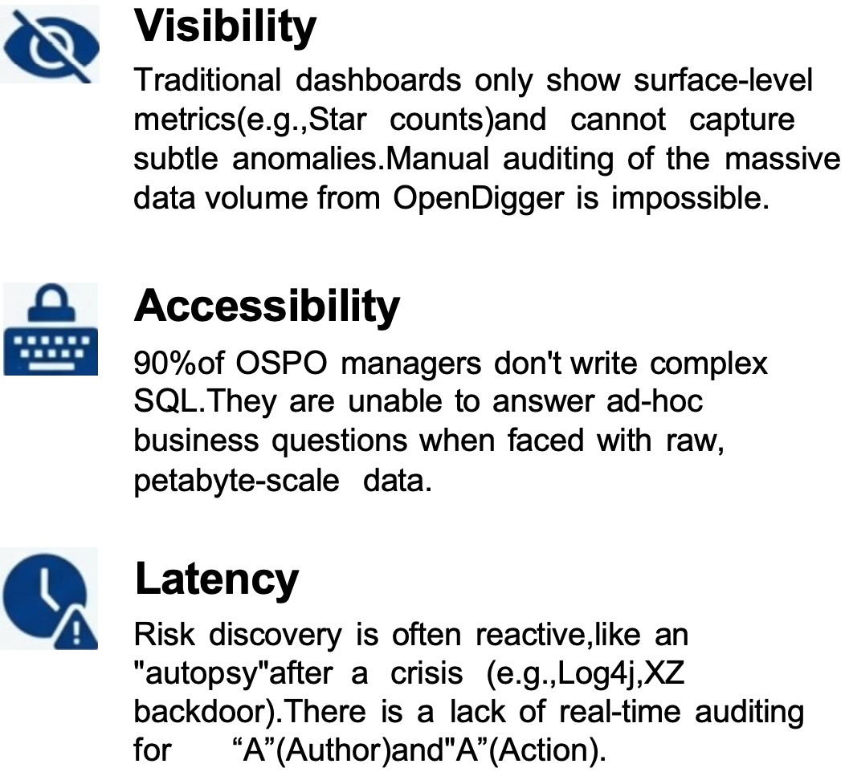
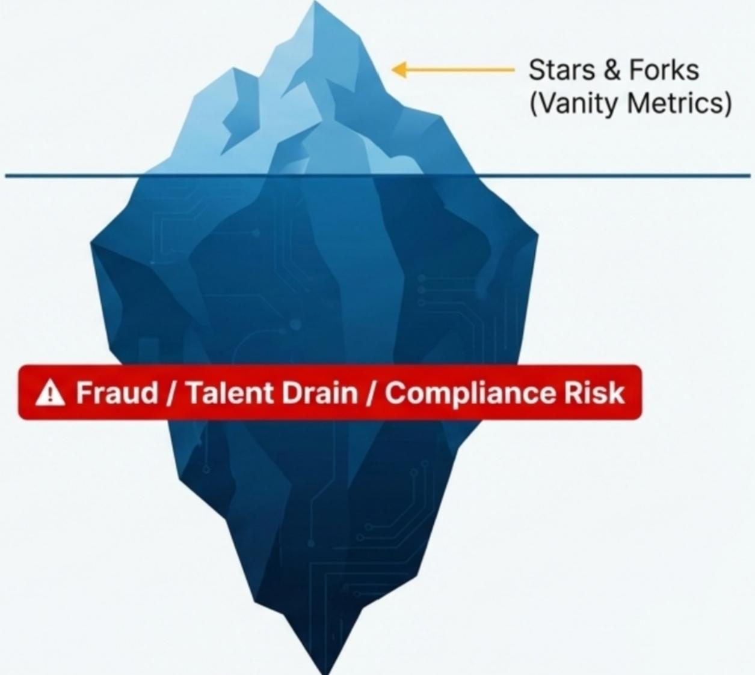
Open-Detective: 开源社区全维风险智能审计系统

Slide 5
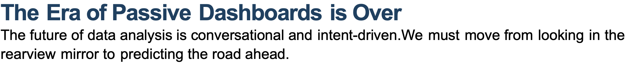
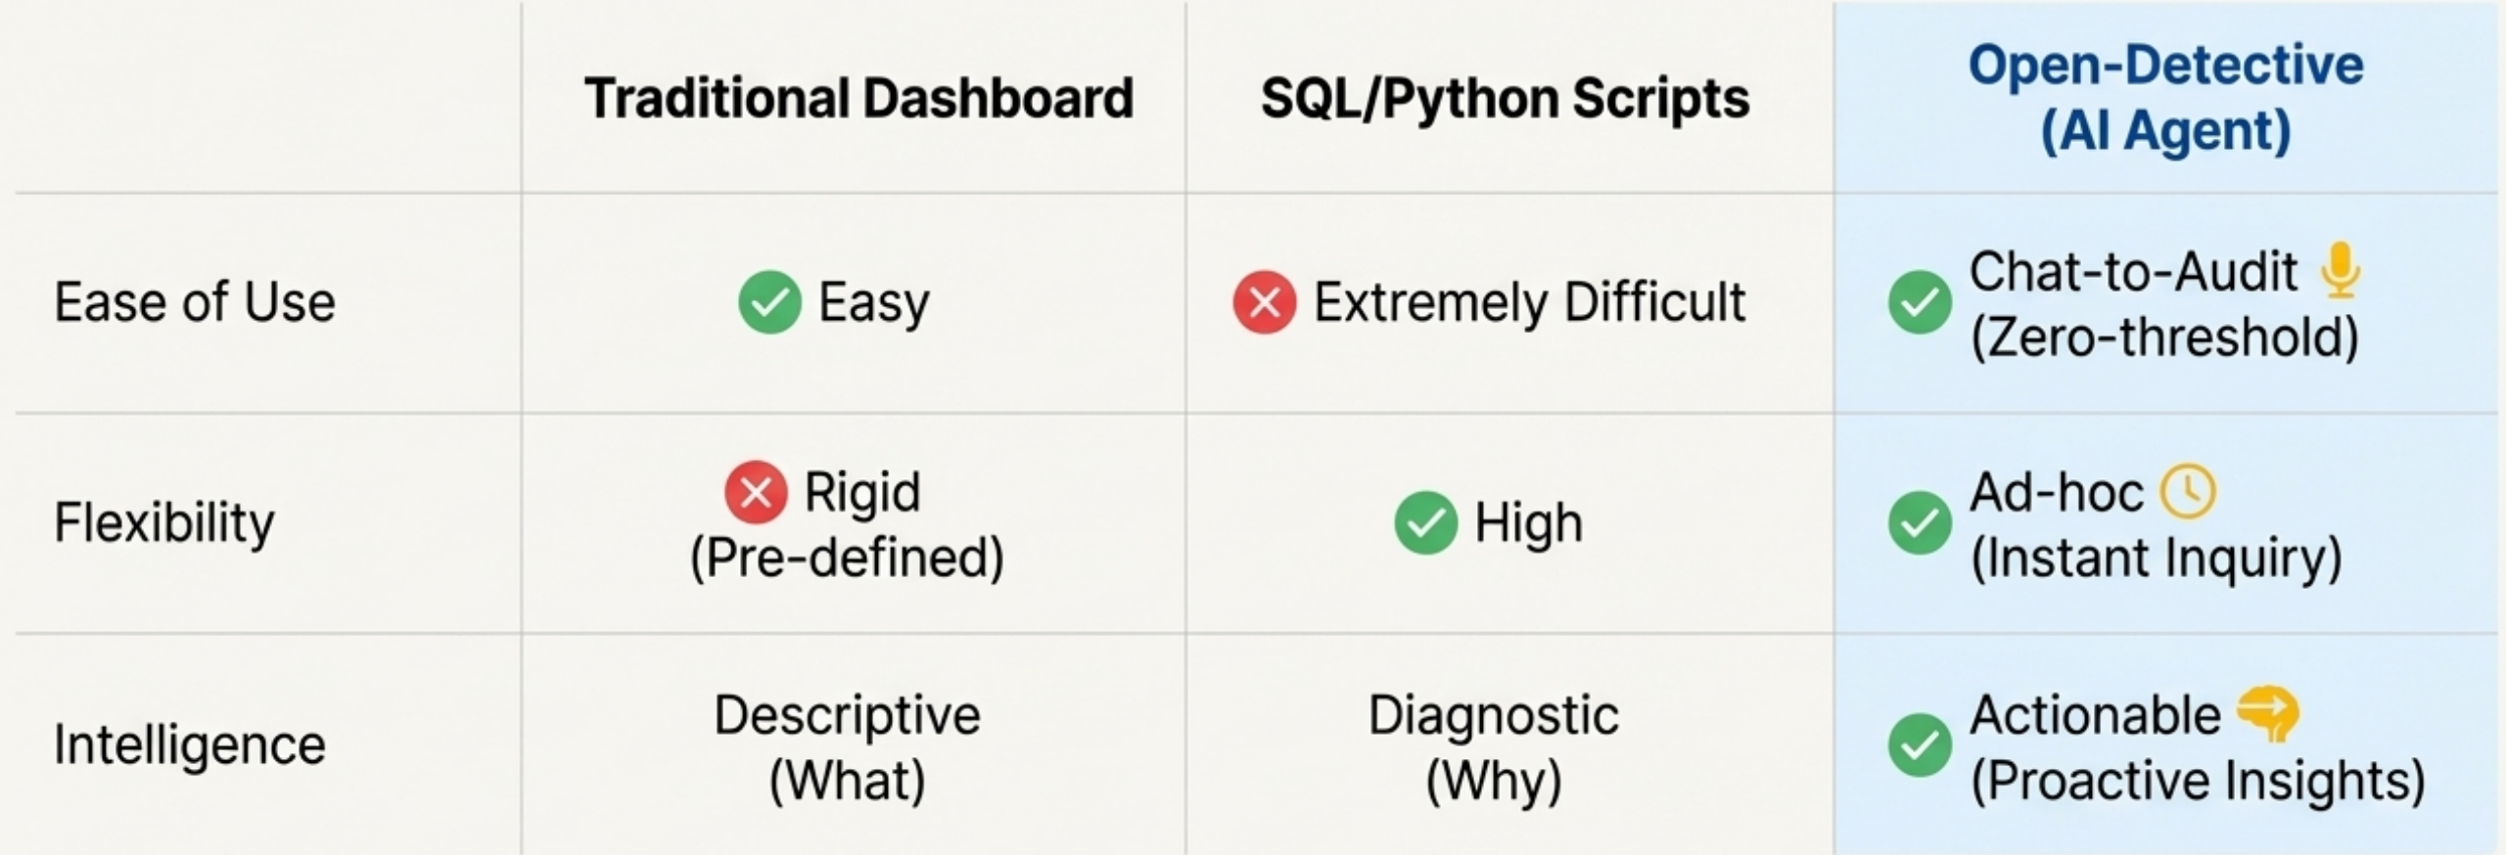
Open-Detective: 开源社区全维风险智能审计系统

Slide 6
项目概述
02

Slide 7

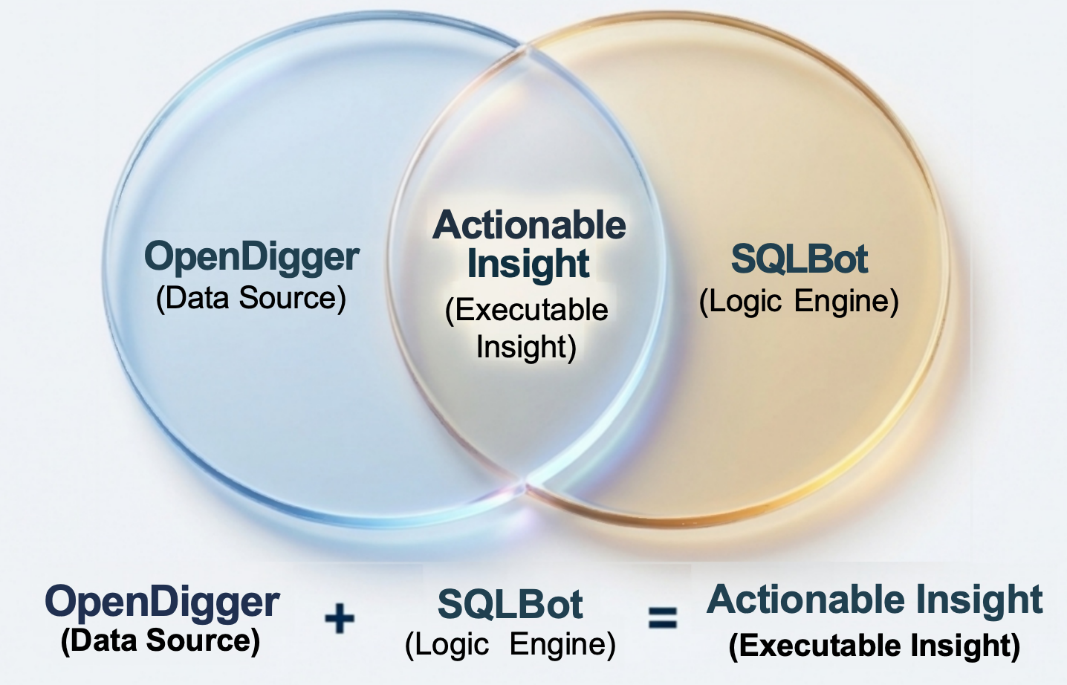
Open-Detective: 开源社区全维风险智能审计系统
How it Works:
Open-Detective is an interactive Al Agent based on Text-to-SQL technology.It empowers
non-technical managers to
conduct complex investigations, support multi-turn dialogue,
detect anomalies,and
generate visualizations using simple natural language.

Slide 8
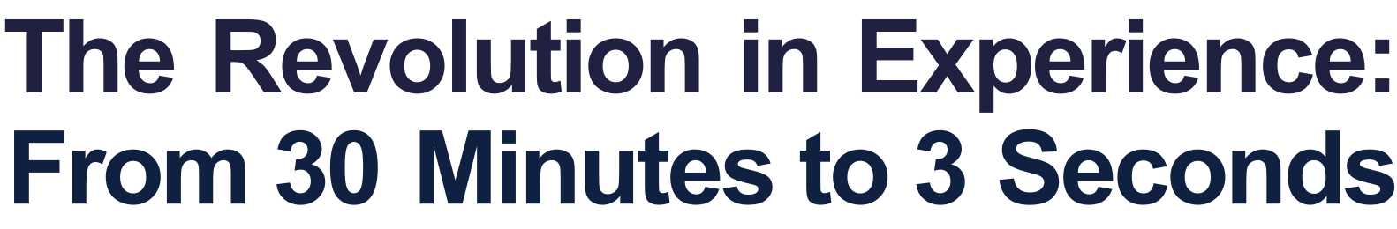
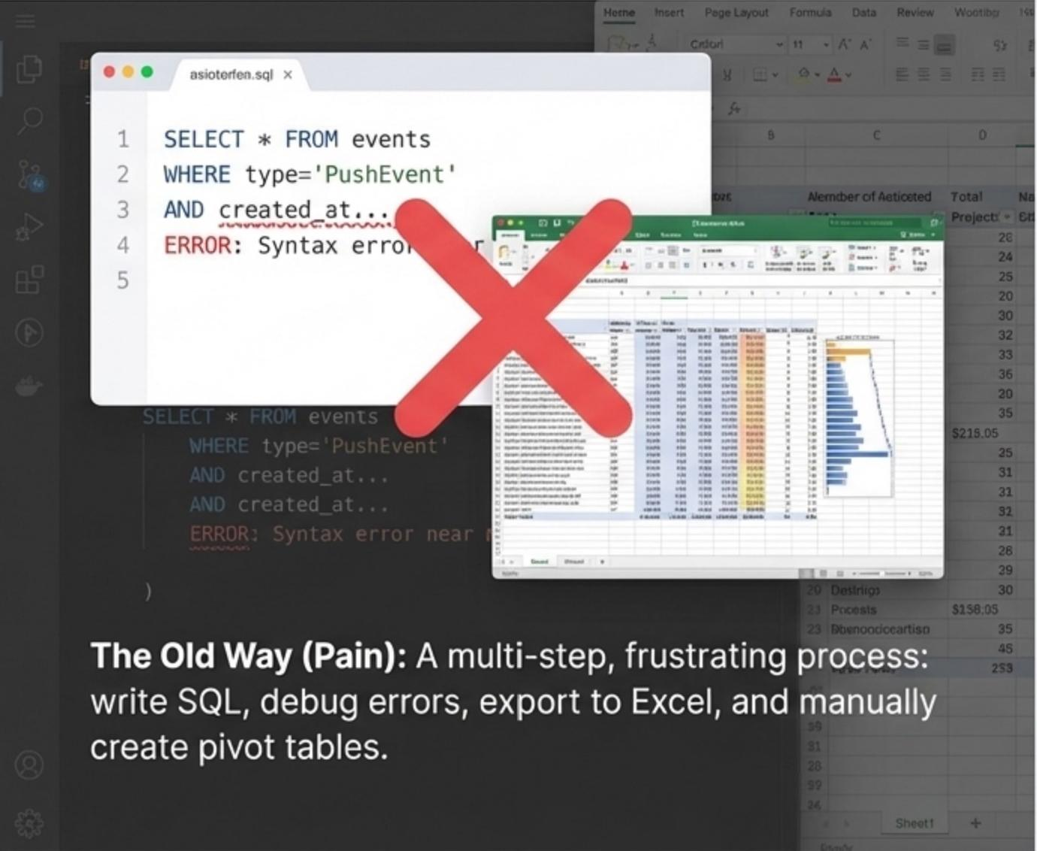
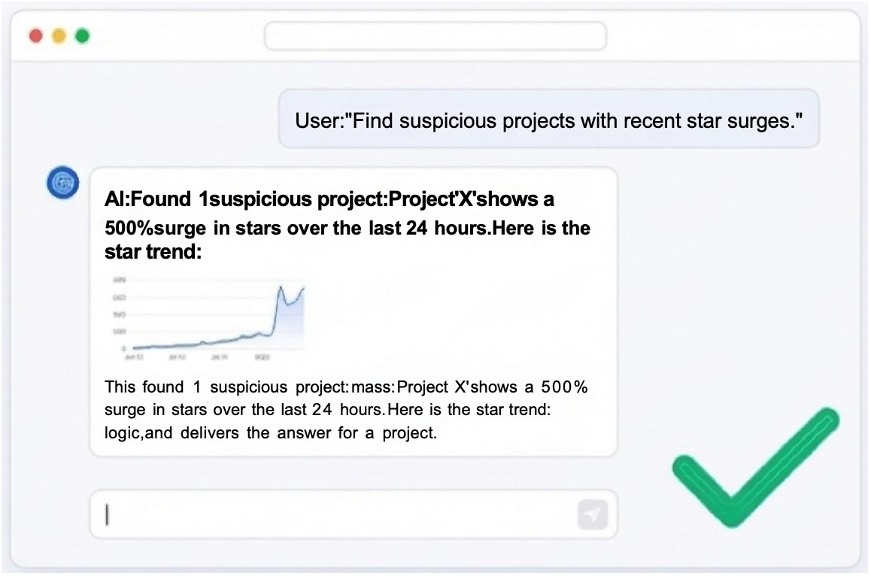
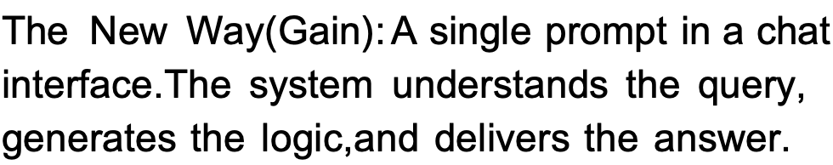
Open-Detective: 开源社区全维风险智能审计系统

Slide 9
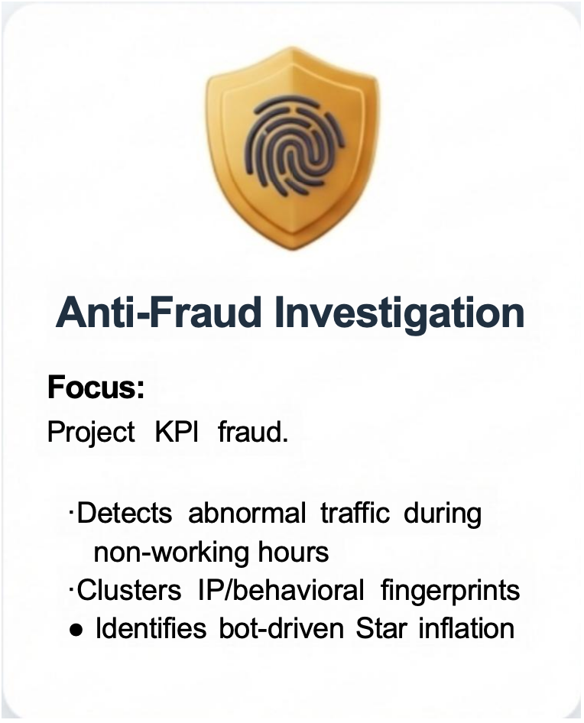
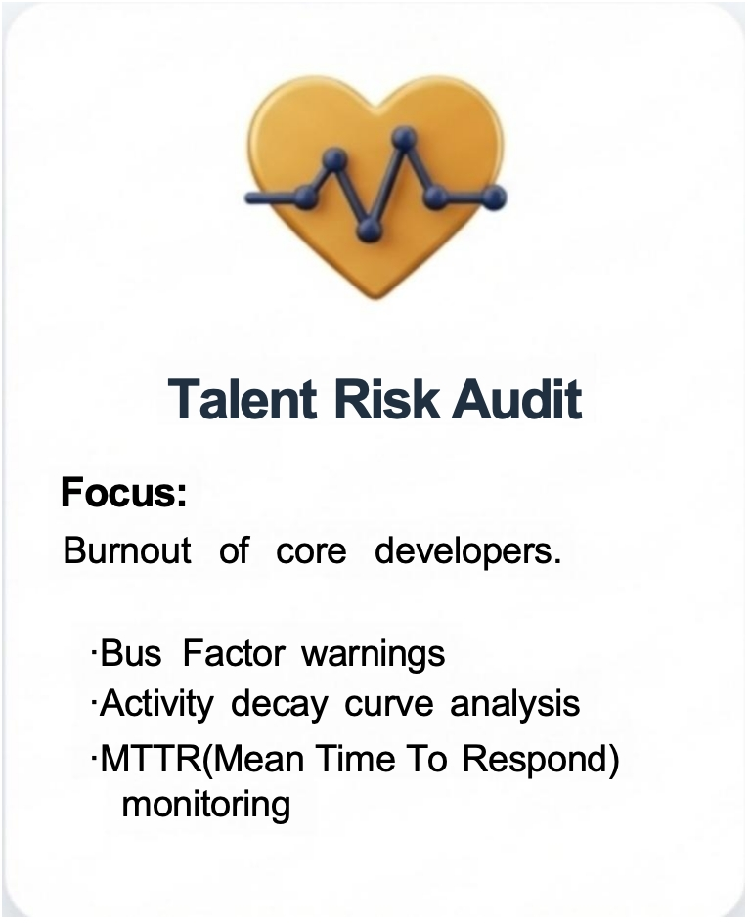
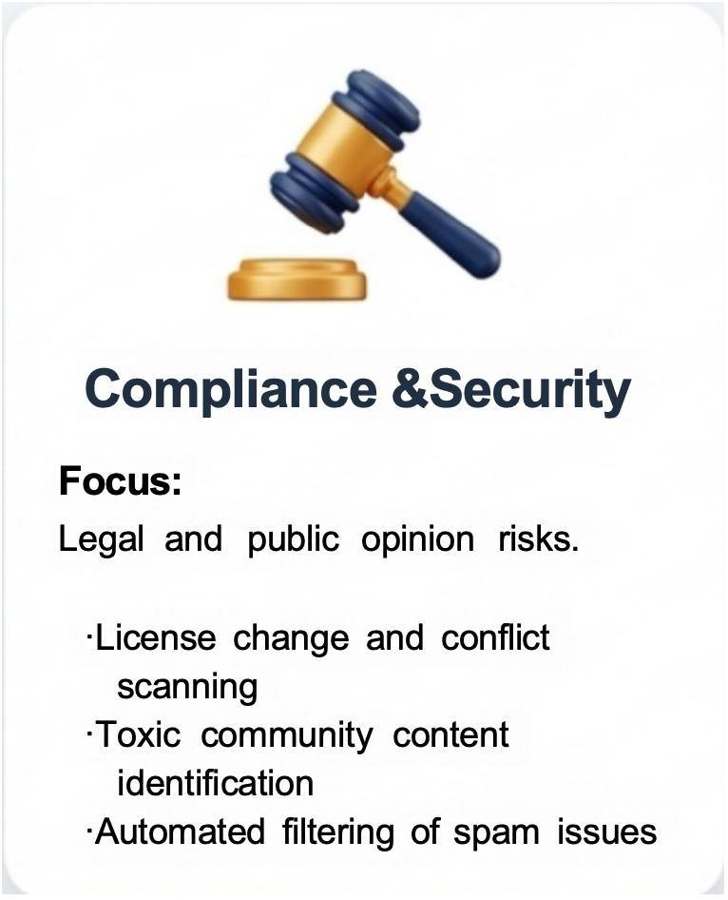
Open-Detective: 开源社区全维风险智能审计系统
Three Core Case Files Covering the Full
Lifecycle of Open Source Governance

Slide 10
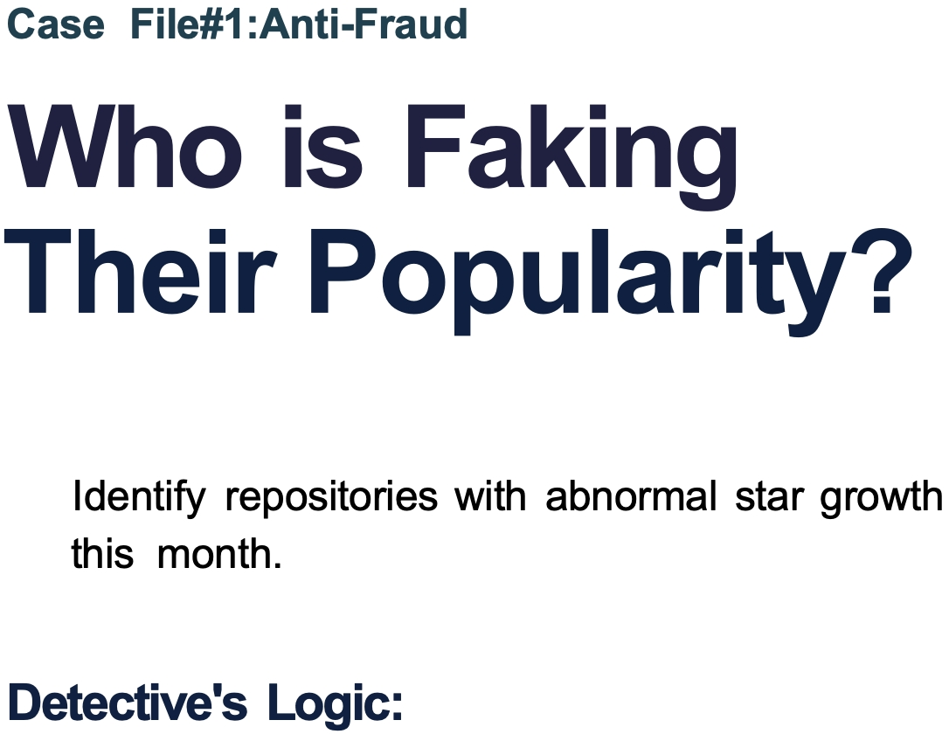
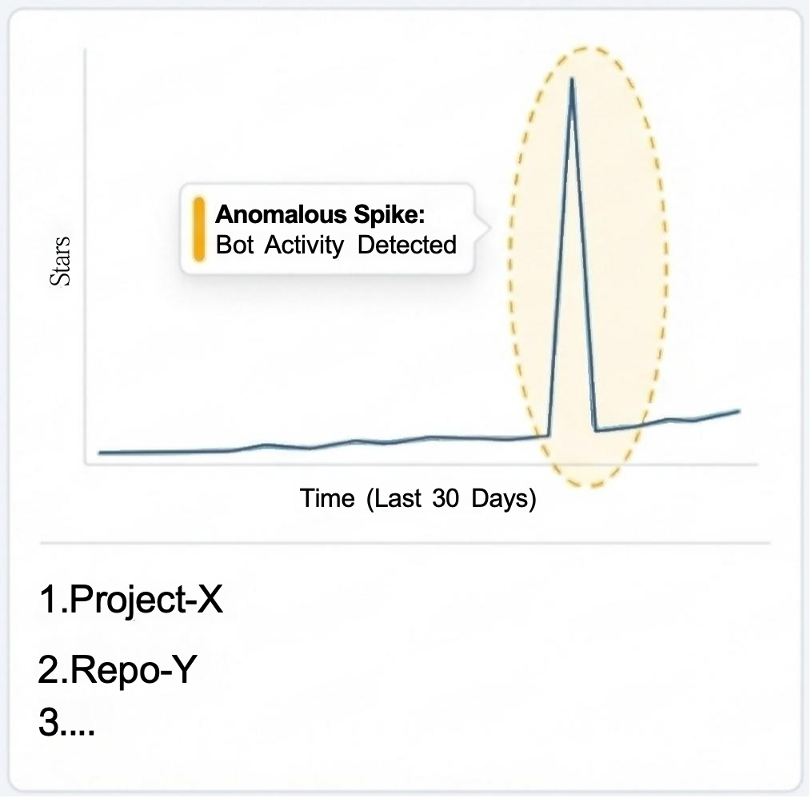
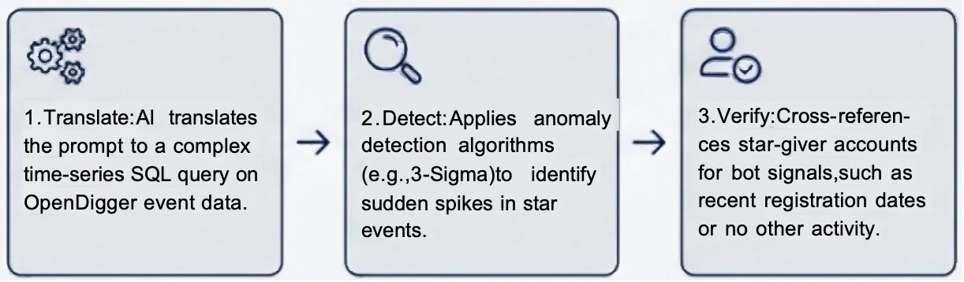
Open-Detective: 开源社区全维风险智能审计系统

Slide 11
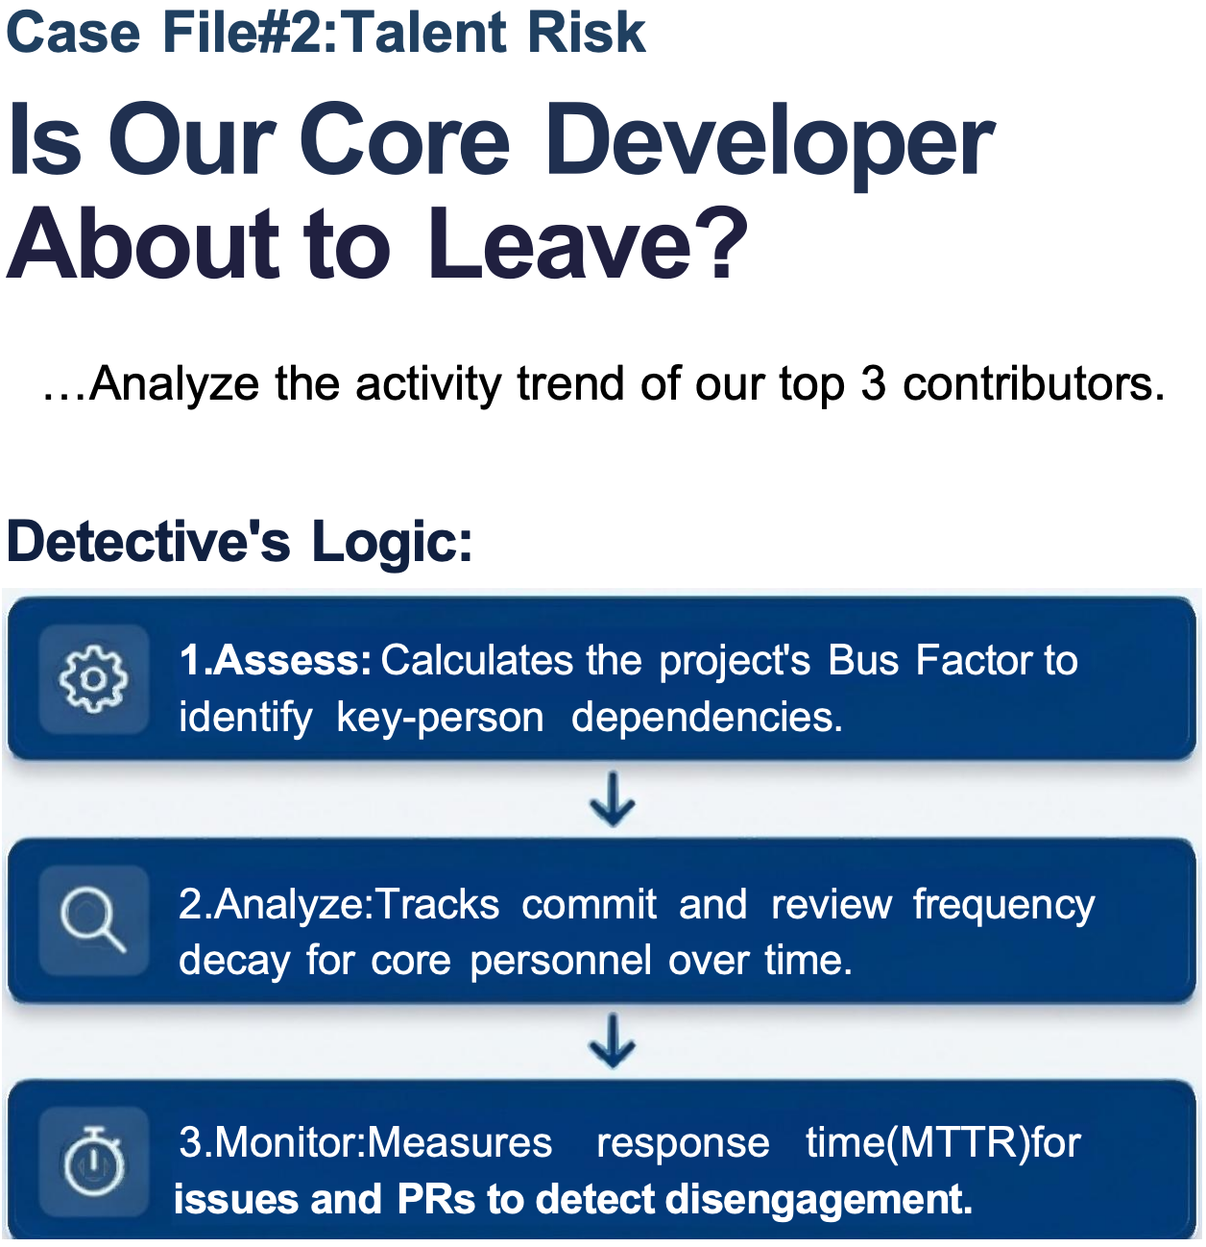
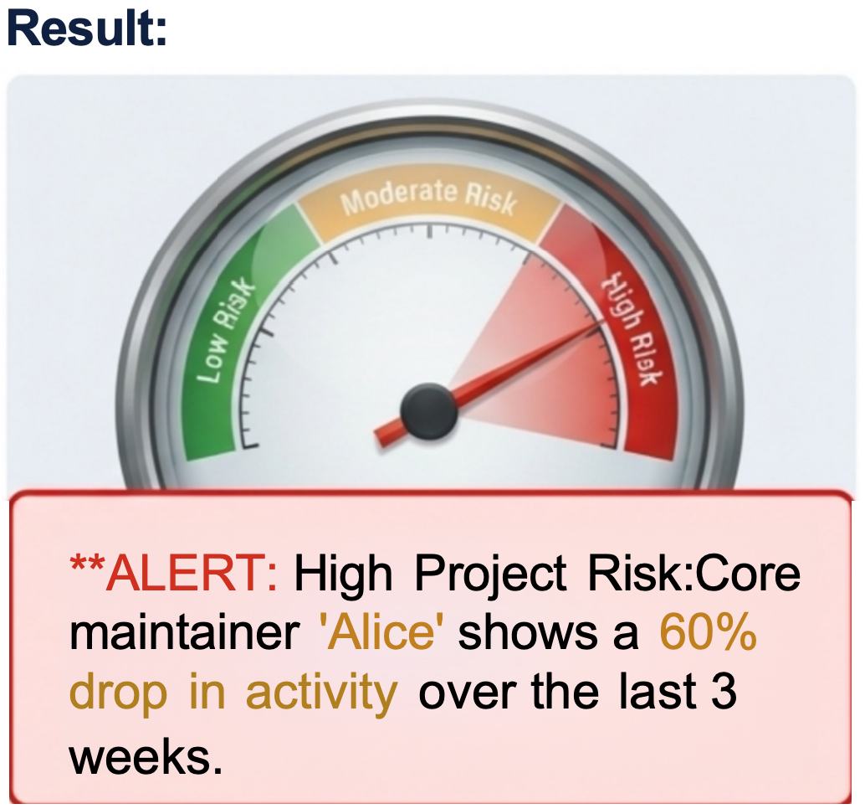

Open-Detective: 开源社区全维风险智能审计系统

Slide 12
技术框架及重难点
03

Slide 13
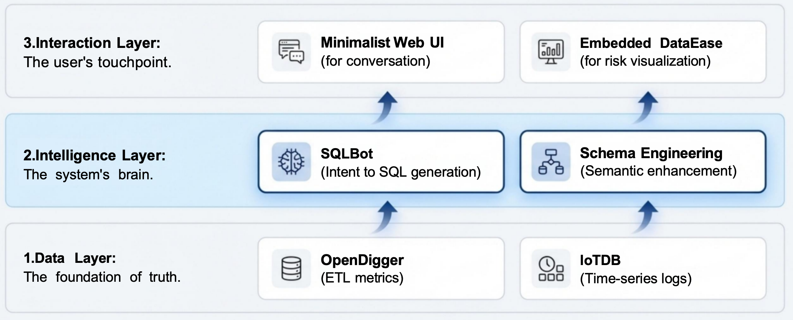
Open-Detective: 开源社区全维风险智能审计系统
A Three-Layer Intelligence Architecture

Slide 14
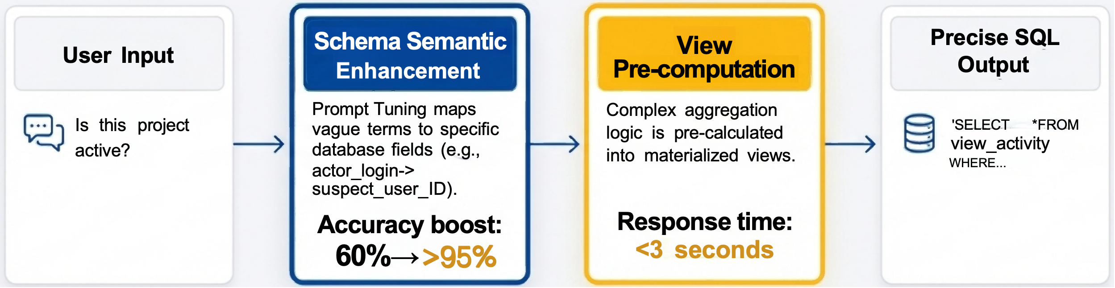
Open-Detective: 开源社区全维风险智能审计系统
How We Make the AI Detective Both Accurate and Fast
Breakthrough 1:Solving Hallucination
We perform Prompt Tuning on over 50+
complex OpenDigger fields to make the Al truly understand business terminology.
Breakthrough 2:Solving Slow Queries
We encapsulate complex query logic into
database Views,simplifying the AI's reasoning path for second-level response times.

Slide 15
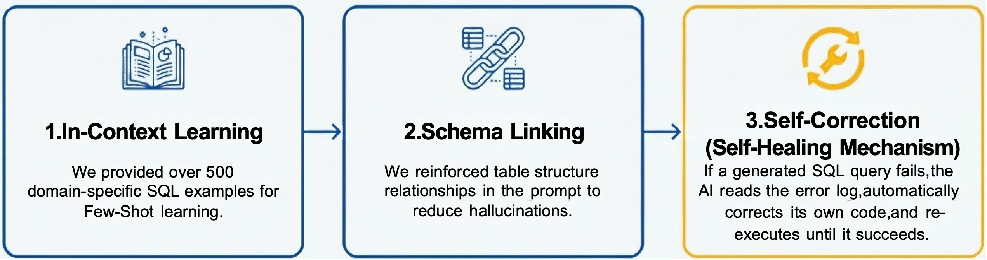
Open-Detective: 开源社区全维风险智能审计系统
The Secret Weapon:Why Our SQLBot Is Smarter
The Problem: General-purpose LLMs have a raw SQL generation accuracy of only ~30%,which is unusable in production.
Our Solution: A Three-Pronged Optimization
The Result: Final execution success rate is over 95%.

Slide 16
Open-Detective: 开源社区全维风险智能审计系统
Let's Make Open Source
Transparent and Trustworthy

